Slide 1
Coulomb’s Law
Week-06

Slide 2
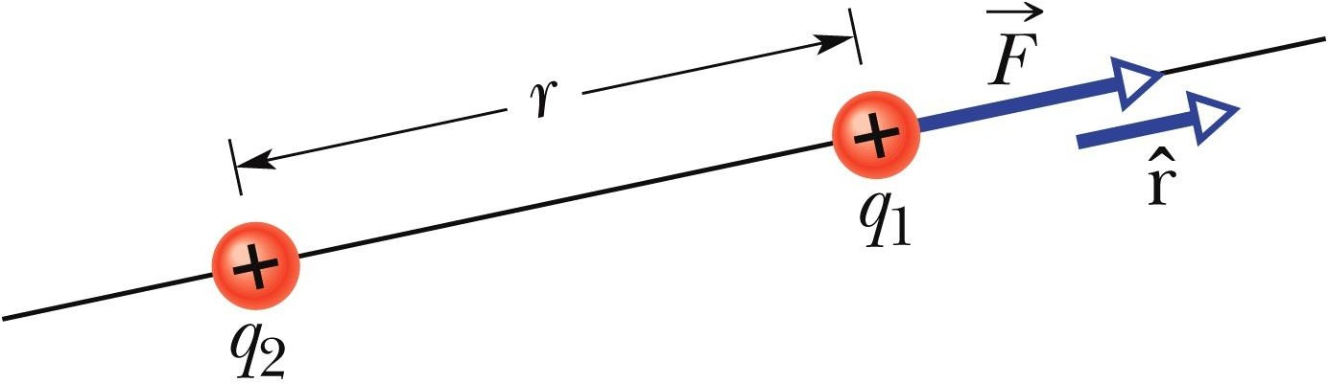

Coulomb’s Law
Coulomb’s law describes the electrostatic force (or electric force) between two charged particles. If the particles have charges q₁ and q₂, are separated by distance r, and are at rest (or moving only slowly) relative to each other, then the magnitude of the force acting on each due to the other is given by
The electrostatic force on particle 1 can be described in terms of a unit vector r along an axis through the two particles, radially away from particle 2.
where ε₀ = 8.85 ×10⁻¹² C²/N.m² is the permittivity constant. The ratio 1/4πε₀ is often replaced with the electrostatic constant (or Coulomb constant) k=8.99×10⁹ N.m²/C². Thus k = 1/4πε₀ .

Slide 3
Coulomb's Law
According to Coulomb’s law, the force of attraction or repulsion between two charged bodies is directly proportional to the product of their charges and inversely proportional to the square of the distance between them.
It acts along the line joining the two charges considered to be point charges.

Slide 4

F is the force
k is the Coulomb’s constant. k=8.99×10⁹ N.m²/C²
q1 and q2 are charges
r is the distance between two charges.

Slide 5
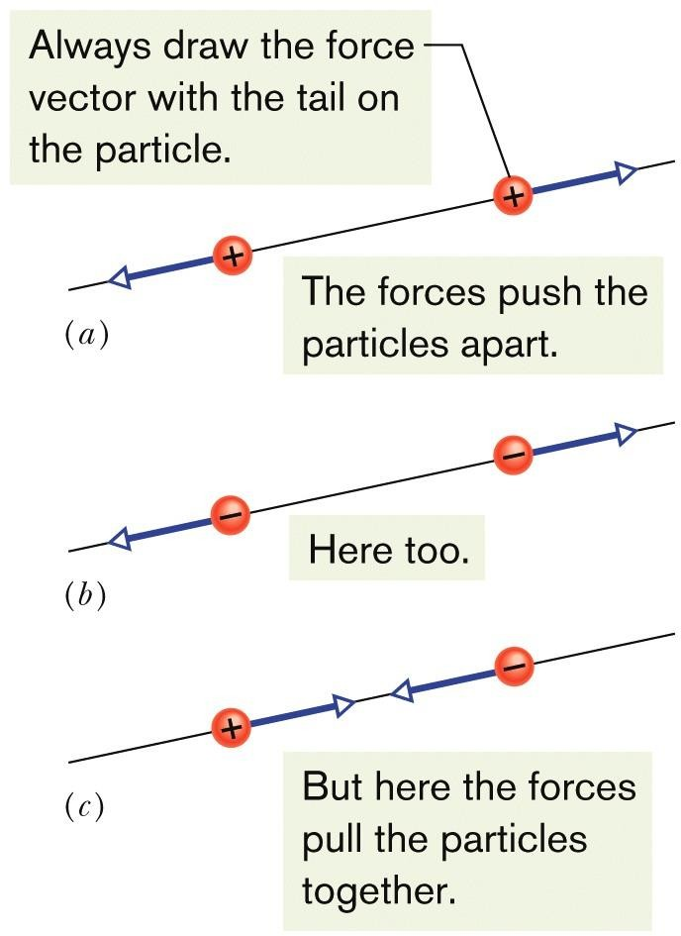
Coulomb’s Law
The electrostatic force vector acting on a charged particle due to a second charged particle is either directly toward the second particle (opposite signs of charge) or directly away from it (same sign of charge).
If multiple electrostatic forces act on a particle, the net force is the vector sum (not scalar sum) of the individual forces.
Two charged particles repel each other if
they have the same sign of charge, either
  both positive or (b) both negative. (c) They attract each other if they have opposite signs of charge.

Slide 6
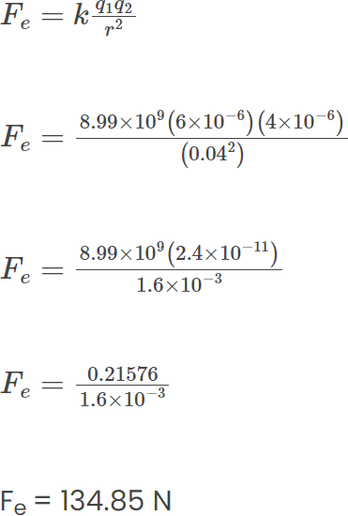
Problem_01: A positive charge of 6×10⁻⁶ C is 0.040m from the second positive charge of 4×10⁻⁶ C Calculate the force between the charges.
Given
k = 8.988 x 10⁹ Nm²C⁻²
q₁ = 6 ×10⁻⁶ C
q₂ = 4 ×10⁻⁶ C r = 0.040 m

Slide 7
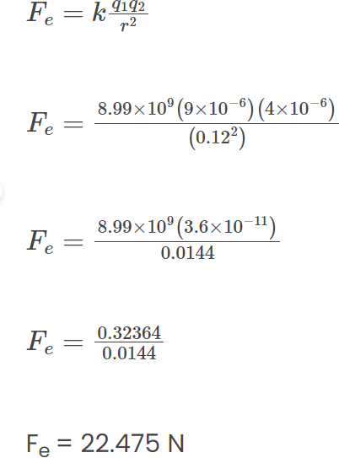
Problem_02: Two-point charges, q₁ = +9 μC and q₂ = 4 μC, are separated by a distance r = 12 cm.
What is the magnitude of the electric force?
k = 8.988 x 10⁹ Nm²C⁻²
q₁ = 9 ×10⁻⁶ C
q₂ = 4 ×10⁻⁶ C
r = 12cm = 0.12 m

Slide 8

Fnet=0
a
a
a
a

Slide 9
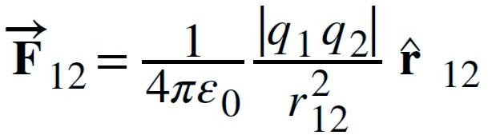
Coulomb’s Law
Multiple Forces: If multiple electrostatic forces act on a particle, the net force is the vector sum (not scalar sum) of the individual forces.
F1=F2
Find force F on q2 due to q1
Find force F on q1 due to q2
F1
F2
q1=q
q2=q

Slide 10
Find force F on q2 due to q1
Find force F on q1 due to q2
𝑞1𝑞2
𝐹 = 𝑘 , 𝑘 =
1
_{𝑟}2
4𝜋𝜀_{𝑜}
𝑞1𝑞2
𝐹 = 𝑘 , 𝑘 =
1
_{𝑟}2
𝑞1𝑞2
r
4𝜋𝜀_{𝑜}
𝑞𝑞
_{𝑞}2
𝐹₁₂ = 𝐹₂₁ = 𝑘
_{𝑟}2
= 𝑘 _{𝑟2} = 𝑘 _{𝑟2}
^{𝐹}21
^{𝐹}12
_{𝑞}2
q1=q
q2=q
𝐹₁₂ = 𝑘 _{𝑟2} 𝑥ො
_{𝑞}2
𝐹₂₁ = −𝑘 _{𝑟2} 𝑥ො
_{𝑞}2
𝐹₁₂ = 𝑘 _{𝑟2} 𝑥ො

Slide 11

𝑞1𝑞2
1
Find force F on q3 due to q1 and q2
𝐹 = 𝑘
_{𝑟}2
, 𝑘 = _{4𝜋𝜀}
𝑜
_{𝑞}2
𝐹₁₃ = 𝑘 _{𝑟2} 𝑥ො
r
r
^{𝐹}23
q3=3q
_{𝑞}2
𝐹₂₃ = 𝑘 _{𝑟2} 𝑥
q1=q
q2=2q
𝑞1𝑞3
𝑞 3𝑞
3𝑞²
= 𝑘
4𝑟²
𝐹₁₃ = 𝑘
₂ = 𝑘
2𝑟
4𝑟²
𝑞2𝑞3
(2𝑞) 3𝑞
6𝑞²
= 𝑘
_{𝑟}2
𝐹₂₃ = 𝑘
= 𝑘
_{𝑟}2
𝑟
2
𝐹_{𝑇} = 𝐹₁₃ + 𝐹₂₃
3𝑞² 6𝑞² 27 𝑞²
𝐹_{𝑇} = 𝑘 _{4𝑟2} + 𝑘 _{𝑟2} = ₄ 𝑘 _{𝑟2} 𝑥

Slide 12
Find force F on q2 due to q1 and q3 _{𝐹 = 𝑘} ^{𝑞1𝑞2} _{, 𝑘 =}
1
_{𝑟}2
4𝜋𝜀_{𝑜}
r
r
q1=q
q2=2q
q3=3q
𝑞1𝑞2
𝑞 2𝑞
2𝑞²
= 𝑘 _{𝑟2}
𝐹₁₂ = 𝑘
= 𝑘
_{𝑟}2
𝑟
2
𝑞2𝑞3
(2𝑞) 3𝑞
6𝑞²
= 𝑘 _{𝑟2}
𝐹₃₂ = 𝑘
= 𝑘
_{𝑟}2
𝑟
2
𝐹_{𝑇} = 𝐹₁₂ + 𝐹₃₂
2𝑞² 6𝑞²
_{𝑞}2
𝐹_{𝑇} = 𝑘 _{𝑟2} − 𝑘 _{𝑟2} = −4𝑘 _{𝑟2} 𝑥

Slide 13

Find force F on q3 due to q1 and q2 _{𝐹 = 𝑘} ^{𝑞1𝑞2} _{, 𝑘 =}
1
_{𝑟}2
4𝜋𝜀_{𝑜}
_{𝑞}2
𝐹₁₃ = 𝑘 _{𝑟2} 𝑥
r
r
_{𝑞}2
𝐹₂₃ = −𝑘 _{𝑟2} 𝑥ො
q1=q
q2=2q
q3=3q
𝑞1𝑞3
𝑞 3𝑞
3𝑞²
= 𝑘
4𝑟²
𝐹₁₃ = 𝑘
₂ = 𝑘
2𝑟
4𝑟²
𝑞2𝑞3
(2𝑞) 3𝑞
6𝑞²
= −𝑘
_{𝑟}2
𝐹₂₃ = 𝑘
= 𝑘
_{𝑟}2
𝑟
2
𝐹_{𝑇} = 𝐹₁₃ + 𝐹₂₃
3𝑞² 6𝑞²
𝐹_{𝑇} = 𝑘 _{4𝑟2} − 𝑘 _{𝑟2} = −
21
_{𝑞}2
𝑘 𝑥
_{𝑟}2
4

Slide 14
Find force F on q2 due to q1 and q3 _{𝐹 = 𝑘} ^{𝑞1𝑞2} _{, 𝑘 =}
1
_{𝑟}2
4𝜋𝜀_{𝑜}
r
r
q1=q
q2=2q
q3=3q

Slide 15
Thanks

